Slide 1

离散数学
Discrete Mathematics
钟芳明
离散数学
Discrete Mathematics

Slide 2
Chapter 4 Binary Relation
4.7 Specific relations

Slide 3
Review
Partition and covering of sets
Equivalence relation
equivalent modulus
equivalence class
Relation between equivalence and partition
Quotient set
Compatibility relation

Slide 4
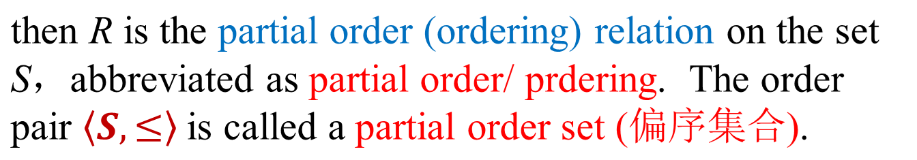
Partial order (偏序) relation
特殊关系
集合的划分和覆盖
等价关系
相容关系
次序关系
偏序集合与哈斯图
Order relation (次序) is a transitive relation on a set, which can provide a method to compare the elements of a set.
Definition：Let R be a binary relation on a set S. if R is reflexive, antisymmetric and transitive, that are
(a)∀x(x∈S→<x,x>∈R)
(b) ∀x∀y (x,y ∈S∧<x,y>∈R∧<y,x>∈R→x=y)
(c)∀x∀y∀z(x,y,z ∈S∧<x,y>∈R∧<y,z>∈R→<x,z>∈R
poset

Slide 5
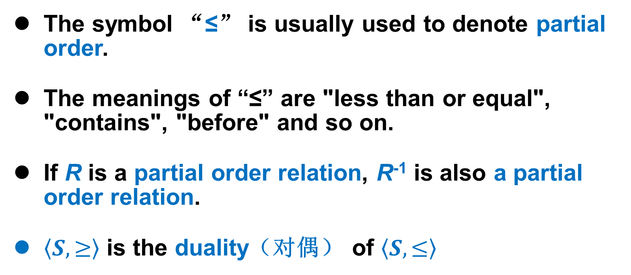
Partial order relation
特殊关系
集合的划分和覆盖
等价关系
相容关系
次序关系
偏序集合与哈斯图
The symbol “≤” is usually used to denote partial order.
The meanings of “≤” are "less than or equal", "contains", "before" and so on.
If R is a partial order relation, R⁻¹ is also a partial order relation.
$\left\langle S,≥\right\rangle$ is the duality（对偶） of $\left\langle S,≤\right\rangle$

Slide 6
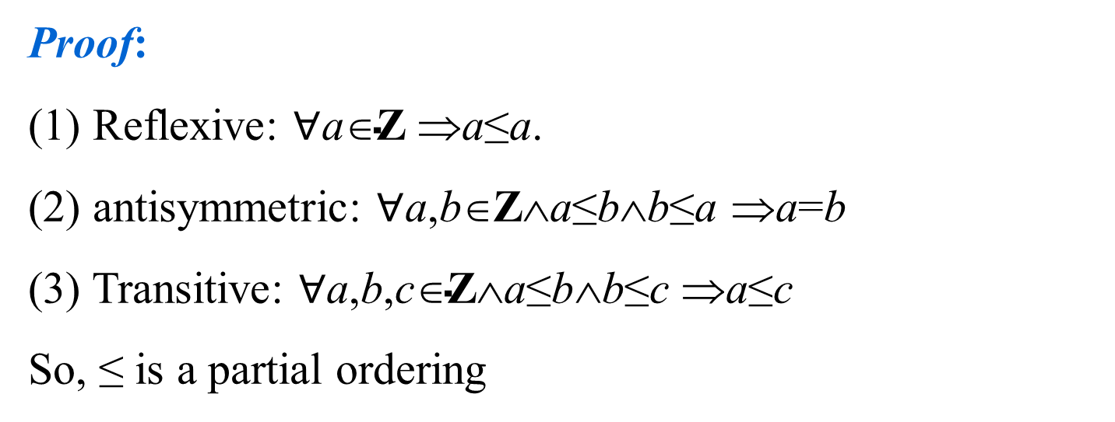
Partial order relation
特殊关系
集合的划分和覆盖
等价关系
相容关系
次序关系
偏序集合与哈斯图
Example: Show that "smaller than or equal" relation (≤) is a partial ordering on the set of integers.
Proof:
(1) Reflexive: $∀\text{a}\text{∈}\text{Z}$ ⇒a≤a.
(2) antisymmetric: $∀$a,b∈Z∧a≤b∧b≤a ⇒a=b
(3) Transitive: $∀\text{a}\text{,}\text{b}\text{,}\text{c}\text{∈}\text{Z}\text{∧}\text{a}\text{≤}\text{b}\text{∧}\text{b}\text{≤}\text{c}$ ⇒a≤c
So, ≤ is a partial ordering

Slide 7
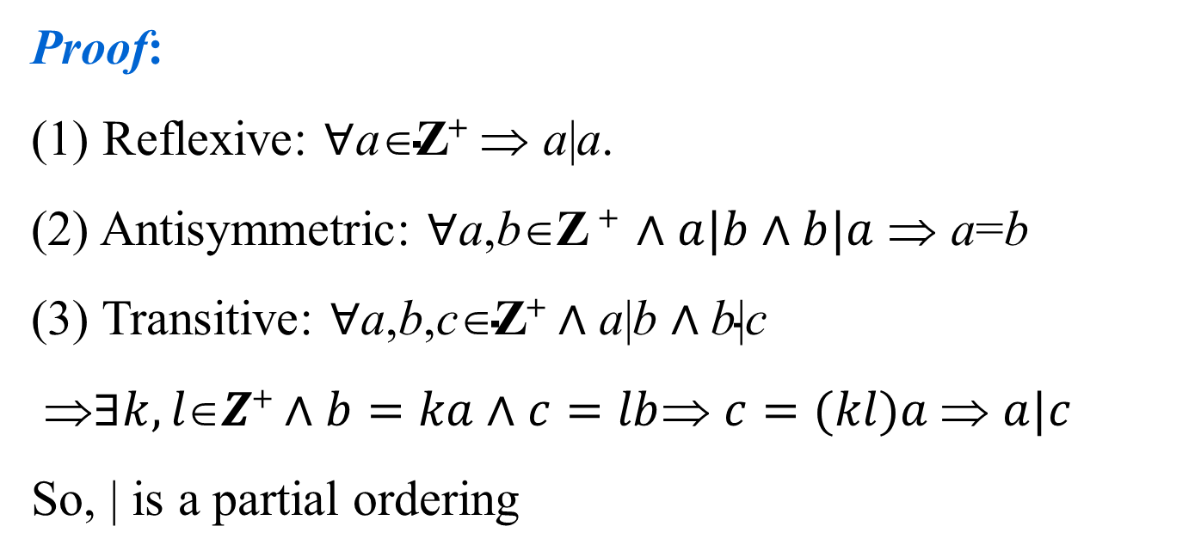
Partial order relation
特殊关系
集合的划分和覆盖
等价关系
相容关系
次序关系
偏序集合与哈斯图
Example: Show that the divisibility relation（整除关系） ( | ) is a partial ordering on the set of positive integers.
Proof:
(1) Reflexive: $∀\text{a}\text{∈}\text{Z}\text{+}$ ⇒ a|a.
(2) Antisymmetric: $∀$a,b∈Z $\text{+} ∧a|b∧b|a$ ⇒ a=b
(3) Transitive: $∀\text{a}\text{,}\text{b}\text{,}\text{c}\text{∈}\text{Z}\text{+}∧\text{a}\text{|}\text{b}∧\text{b}\text{|}\text{c}$
⇒$∃k,l∈Z\text{+}∧b=ka∧c=lb$⇒ $c=(kl)a$⇒ $a|c$
So, | is a partial ordering

Slide 8
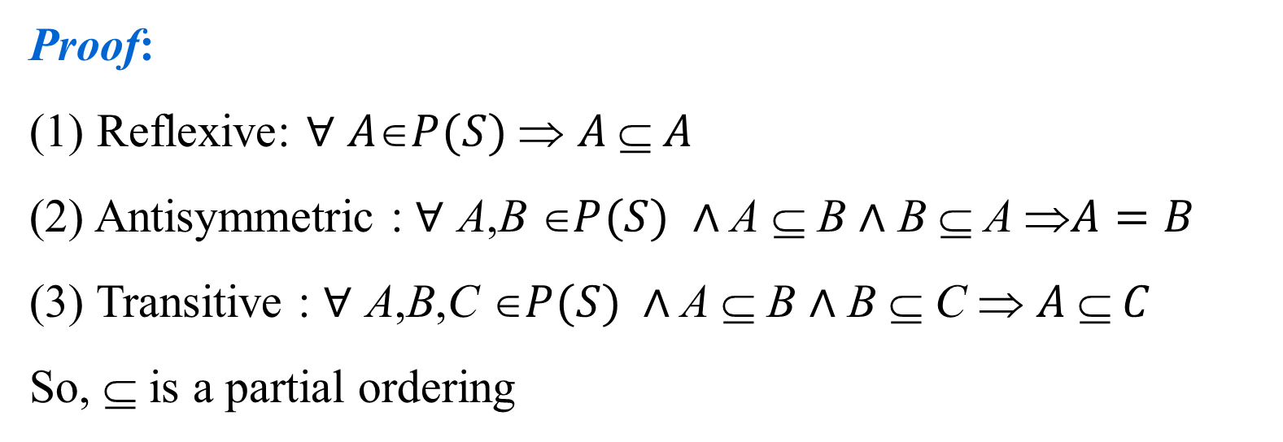
Partial order relation
特殊关系
集合的划分和覆盖
等价关系
相容关系
次序关系
偏序集合与哈斯图
Example: Show that the inclusion relation (⊆) is a partial ordering on the power set of a nonempty set S.
Proof:
(1) Reflexive: $∀$ $A\text{∈}P(S)$⇒ $A  A$
(2) Antisymmetric : ∀ A,B $\text{}P(S)$ $∧$A ⊆ B $∧$ B ⊆ A ⇒$A=B$
(3) Transitive : ∀ A,B,C $\text{}P(S) ∧$A ⊆ B $∧$ B ⊆ C ⇒ $A  C$
So, ⊆ is a partial ordering
The “less than” relation < and “greater than” relation > on number set are not partial ordering (not reflexive)
They are another kind of order relation.

Slide 9
Quasi order (拟序) relation
特殊关系
集合的划分和覆盖
等价关系
相容关系
次序关系
偏序集合与哈斯图
Definition：Let R be a binary relation on a set S. If R is antireflexive and transitive, that are
(a)∀x(x∈S→<x,x>∉R)
(b)∀x∀y∀z(x,y,z ∈S∧<x,y>∈R∧<y,z>∈R→<x,z>∈R
then R is a quasi order relation, denoted by “<”.
Is a quasi order relation antisymmetric? (Yes)
Theorem: Let R be a binary relation on a set S. Then there are:
(a) If R is a quasi order relation, then r(R)=R⋃I_{S} is a partial order relation.
(b) If R is a partial order, then R-I_{S} is a quasi order relation.

Slide 10
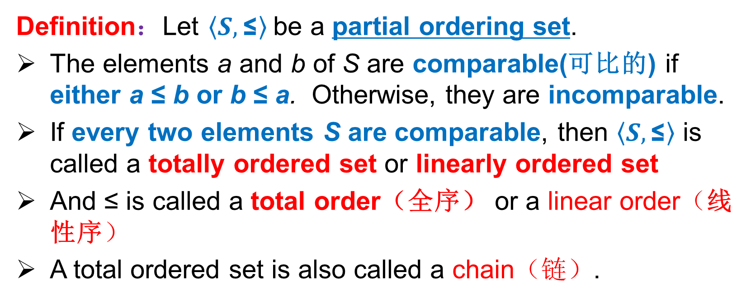
Total order relation (全序关系)
特殊关系
集合的划分和覆盖
等价关系
相容关系
次序关系
偏序集合与哈斯图
Definition：Let $\left\langle S,\text{≤}\right\rangle$be a partial ordering set.
The elements a and b of S are comparable(可比的) if either a ≤ b or b ≤ a. Otherwise, they are incomparable.
If every two elements S are comparable, then $\left\langle S,\text{≤}\right\rangle$ is called a totally ordered set or linearly ordered set
And ≤ is called a total order（全序） or a linear order（线性序）
A total ordered set is also called a chain（链）.

Slide 11
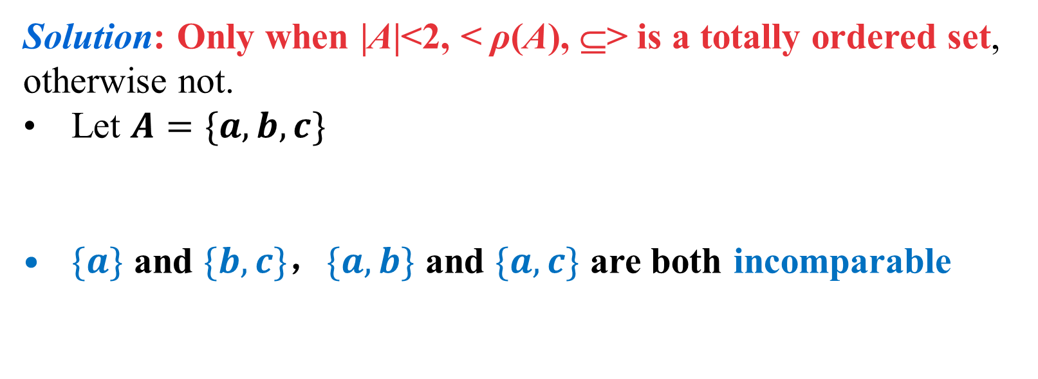
Total order relation (全序关系)
特殊关系
集合的划分和覆盖
等价关系
相容关系
次序关系
偏序集合与哈斯图
Example: Is <ρ(A), ⊆> a totally ordered set where ρ(A) is the power set of a set A?
Solution: Only when |A|<2, < ρ(A), ⊆> is a totally ordered set, otherwise not.
Let $A=\{a,b,c\}$
$\{a\}$ and $\{b,c\}$，$\{a,b\}$ and $\{a,c\}$ are both incomparable

Slide 12
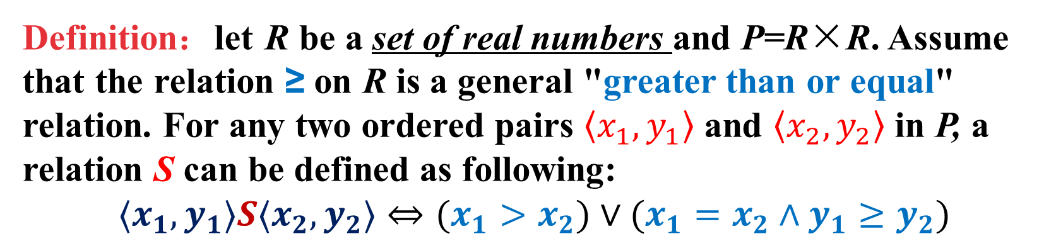
Alphabetical (字母) order relation
特殊关系
集合的划分和覆盖
等价关系
相容关系
次序关系
偏序集合与哈斯图
Definition：let R be a set of real numbers and P=R×R. Assume that the relation ≥ on R is a general "greater than or equal" relation. For any two ordered pairs $〈x_{1},y_{1}〉$ and $〈x_{2},y_{2}〉$ in P, a relation S can be defined as following:
$$〈x_{1},y_{1}〉S〈x_{2},y_{2}〉⇔(x_{1}>x_{2})∨(x_{1}=x_{2}∧y_{1}≥y_{2})$$
If ，then there is , so S is the total order relation on P, and it is called alphabetical order relation or alphabetical order.
For example：

Slide 13
Alphabetical order relation
特殊关系
集合的划分和覆盖
等价关系
相容关系
次序关系
偏序集合与哈斯图
Let R be a totally ordered relation in X, and let
This equation shows that P is composed of a string of elements whose length is less than or equal to n.
Assuming that n takes a fixed value, a string of elements of length m can be regarded as a m ordered tuple.
In this way, we can define the total order relation S in P and call it alphabetical order relation.

Slide 14
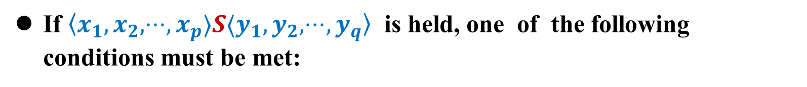
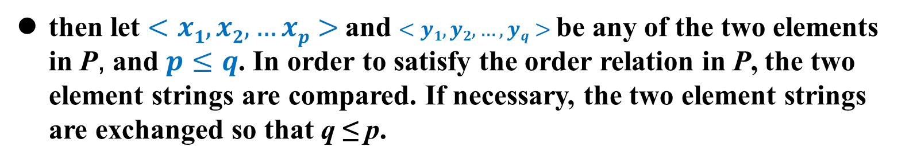
Alphabetical order relation
特殊关系
集合的划分和覆盖
等价关系
相容关系
次序关系
偏序集合与哈斯图
then let $<x1,x2,…xp>$and $<y1,y2,…,yq>$be any of the two elements in P, and $p≤q$. In order to satisfy the order relation in P, the two element strings are compared. If necessary, the two element strings are exchanged so that q ≤ p.
If $〈x_{1},x_{2},⋅⋅⋅,x_{p}〉S〈y_{1},y_{2},⋅⋅⋅,y_{q}〉$ is held, one of the following conditions must be met:
If none of the above conditions is met, it should be:

Slide 15
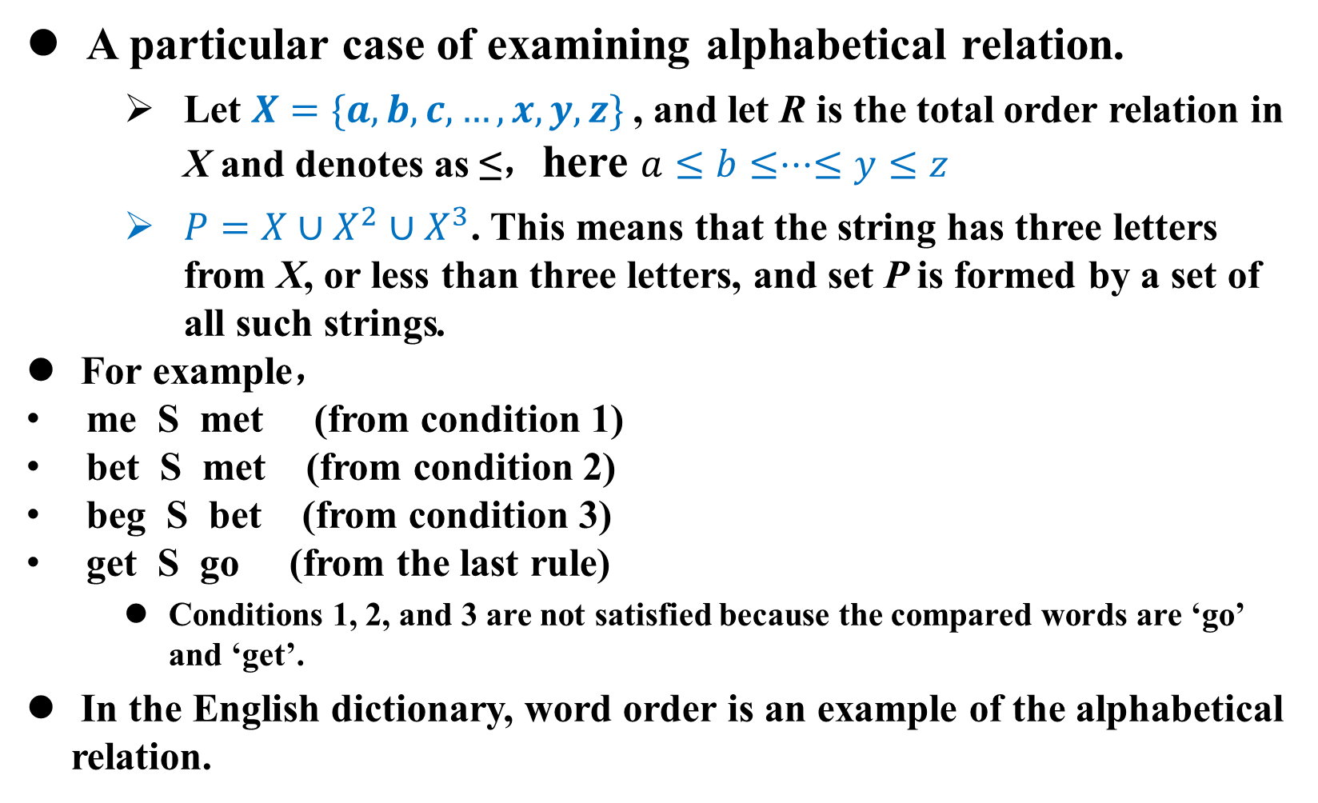
Alphabetical order relation
A particular case of examining alphabetical relation.
Let $X=\{a,b,c,…,x,y,z\}$, and let R is the total order relation in X and denotes as ≤，here $a≤b≤⋅⋅⋅≤y≤z$
$P=X∪X^{2}∪X^{3}$. This means that the string has three letters from X, or less than three letters, and set P is formed by a set of all such strings.
For example，
me S met (from condition 1)
bet S met (from condition 2)
beg S bet (from condition 3)
get S go (from the last rule)
Conditions 1, 2, and 3 are not satisfied because the compared words are ‘go’ and ‘get’.
In the English dictionary, word order is an example of the alphabetical relation.
特殊关系
集合的划分和覆盖
等价关系
相容关系
次序关系
偏序集合与哈斯图

Slide 16
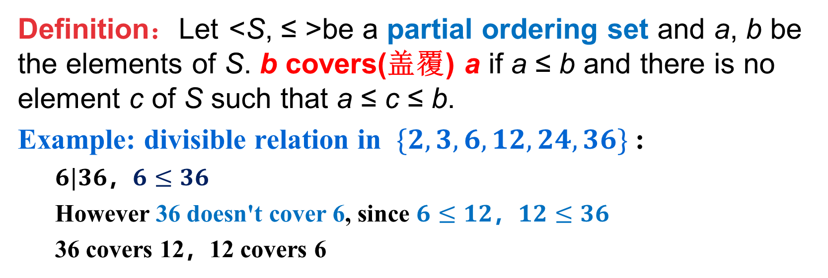
Hasse diagram(哈斯图)
特殊关系
集合的划分和覆盖
等价关系
相容关系
次序关系
偏序集合与哈斯图
A Hasse diagram is a visual representation of a partial ordering where many edges do not have to be shown because they must be present, such as the reflexive and transitive edges.
It can be considered as a simplification of the digraph of a partial ordering.
Definition：Let <S, ≤ >be a partial ordering set and a, b be the elements of S. b covers(盖覆) a if a ≤ b and there is no element c of S such that a ≤ c ≤ b.
Example: divisible relation in $\{2,3,6,12,24,36\}$:
$6|36$，$6≤36$
However 36 doesn't cover 6, since $6≤12$，$12≤36$
36 covers 12，12 covers 6

Slide 17
Hasse diagram(哈斯图)
特殊关系
集合的划分和覆盖
等价关系
相容关系
次序关系
偏序集合与哈斯图
对偏序关系的关系图可进行如下简化：
自反性：可以将各顶点上的环全部略去；
反对称性：边为单向，可以规定向上方向为箭头方向，省略箭头；
传递性：可以将由传递性导出的边省去。
将经过上述简化后得到的关系图称为哈斯图。

Slide 18
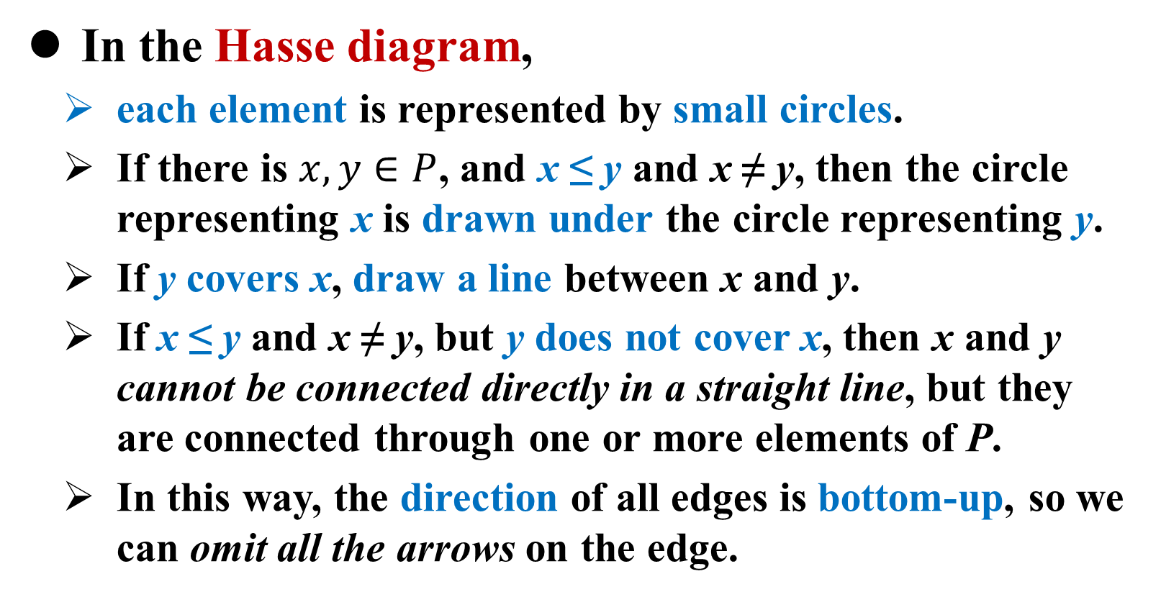
Hasse diagram
特殊关系
集合的划分和覆盖
等价关系
相容关系
次序关系
偏序集合与哈斯图
In the Hasse diagram,
each element is represented by small circles.
If there is $x,y∈P$, and x ≤ y and x ≠ y, then the circle representing x is drawn under the circle representing y.
If y covers x, draw a line between x and y.
If x ≤ y and x ≠ y, but y does not cover x, then x and y cannot be connected directly in a straight line, but they are connected through one or more elements of P.
In this way, the direction of all edges is bottom-up, so we can omit all the arrows on the edge.

Slide 19
Hasse diagram
特殊关系
集合的划分和覆盖
等价关系
相容关系
次序关系
偏序集合与哈斯图
For finite posets, Hasse diagram is a simplification of relation graph.
E.g.： divisible relation in {2,4,6,8}
8
8
4
6
4
6
2
2
relation graph
Hasse diagram

Slide 20
Hasse diagram
特殊关系
集合的划分和覆盖
等价关系
相容关系
次序关系
偏序集合与哈斯图
For example： Let P₁={1,2,3,4}，≤ is a “less than or equal” relation，then is a totally ordered set. Let ，≤ is the inclusion relation in P₂，then is a totally ordered set. Try to draw the Hasse diagram of and
Note: although two totally ordered relationships are defined differently, they may have the same structure in Hassee graphs.

Slide 21
Hasse diagram
特殊关系
集合的划分和覆盖
等价关系
相容关系
次序关系
偏序集合与哈斯图
Example： Let S={2,3,6,12,24,36} and ≤ be the divisible relation on S, that is a≤b if a divides b. Obviously,<S, ≤> is a poset. Find the order pairs in the relation and draw the Hasse diagram of S

Slide 22
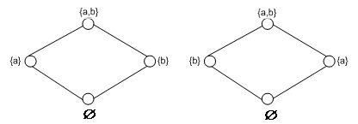
Hasse diagram
特殊关系
集合的划分和覆盖
等价关系
相容关系
次序关系
偏序集合与哈斯图
Example： Let A={a, b} and P(A) be its power set. Then <P(A),⊆> is a poset. Draw the Hasse diagram of P(A)
Note: for a given set of partial orders, its Hasse diagram is not unique. From the Hasse diagram of <P,≤>, the Hasse diagram of its dual <P, ≥ > can be obtained. It is only necessary to flip its Hasse diagram vertically, so that the node originally at the top becomes the top node at the bottom.

Slide 23
Hasse diagram and Special elements
特殊关系
集合的划分和覆盖
等价关系
相容关系
次序关系
偏序集合与哈斯图
Special elements in partially ordered set
最小元 最大元
极小元 极大元
下界 上界
下确界 上确界

Slide 24
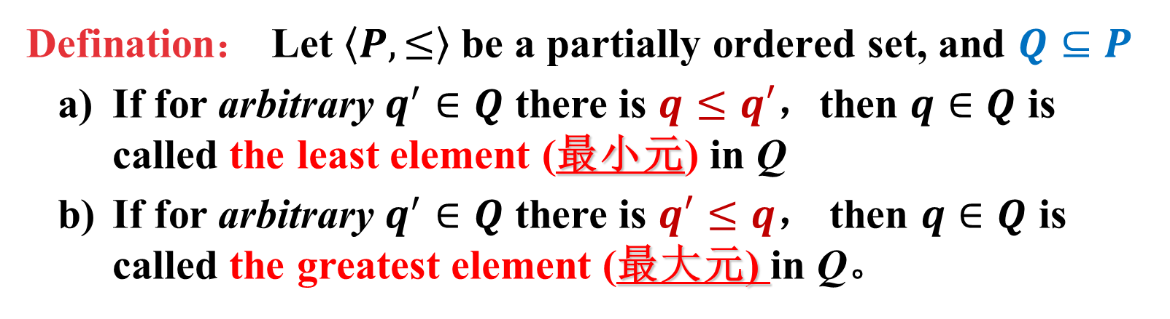
Hasse diagram and Special elements
特殊关系
集合的划分和覆盖
等价关系
相容关系
次序关系
偏序集合与哈斯图
Defination： Let $〈P,≤〉$ be a partially ordered set, and $Q⊆P$
If for arbitrary $q^{′}∈Q$ there is $q≤q′$，then $q∈Q$ is called the least element (最小元) in Q
If for arbitrary $q^{′}∈Q$ there is $q′≤q$， then $q∈Q$ is called the greatest element (最大元) in Q。
The greatest/least element is unique when it exists.
If we can draw Hasse diagram, we can see whether there are largest members and smallest members.

Slide 25
Special elements
特殊关系
集合的划分和覆盖
等价关系
相容关系
次序关系
偏序集合与哈斯图
Theorem：let <S, ≤> be a poset, and A⊆S. If both x and y are the least elements（the greatest element） of A, they must be equal x=y.
Proof：
Suppose x and y are both the least elements of A.
Then there is x≤y and y≤x.
According to the antisymmetric property of partial order relation, x=y can be obtained.

Slide 26
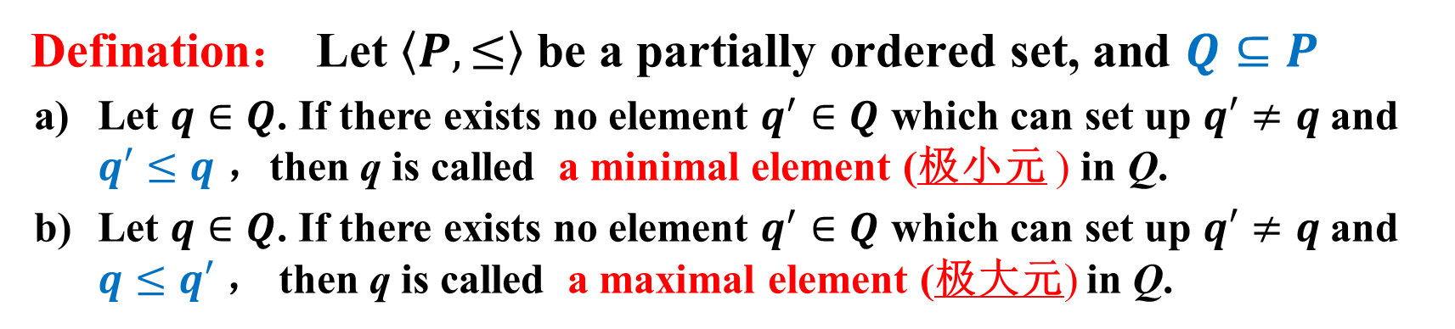
Hasse diagram and Special elements
特殊关系
集合的划分和覆盖
等价关系
相容关系
次序关系
偏序集合与哈斯图
Defination： Let $〈P,≤〉$ be a partially ordered set, and $Q⊆P$
Let $q∈Q$. If there exists no element $q^{′}∈Q$ which can set up $q′≠q$ and $q′≤q$ ，then q is called a minimal element (极小元 ) in Q.
Let $q∈Q$. If there exists no element $q^{′}∈Q$ which can set up $q′≠q$ and $q≤q′$， then q is called a maximal element (极大元) in Q.
The maximal and minimal elements are not unique.
Different maximal elements (or different minimal elements) are not comparable.

Slide 27
Special elements
特殊关系
集合的划分和覆盖
等价关系
相容关系
次序关系
偏序集合与哈斯图
Example：
The least (greatest) element may exist or may not exist. If it exists, it must be unique.
The minimal (maximal) element must exist and may not be unique.

Slide 28
Bounds
特殊关系
集合的划分和覆盖
等价关系
相容关系
次序关系
偏序集合与哈斯图
Definition： Let <P, ≤> be a poset, and Q⊆P
For u∈P, if q≤u for all q∈Q, u is called the upper bound (上界) of Q.
For u∈P, if u≤q for all q∈Q, u is called the lower bound (下界) of Q.

Slide 29
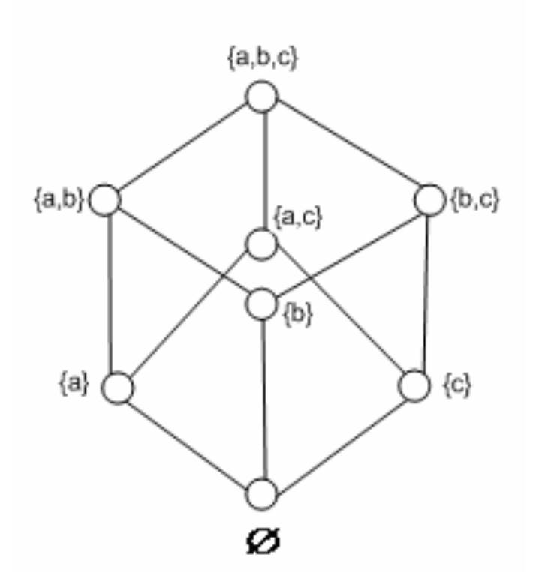
Partial ordered set and Hass Graph
特殊关系
集合的划分和覆盖
等价关系
相容关系
次序关系
偏序集合与哈斯图
For example：let X={a, b, c}， is its power set. The partial order relation ≤ between elements of is the inclusion relation . Try to draw the Hasse diagram of , and point out the upper bound and lower bound of the subset of .
First select a subset of that is A={{b, c}, {b},{c}}. Then X and {b, c} are the upper bound of A，Ф is the lower bound of it.
For , it’s subset B={{a, c},{c}}，the upper bound is X and {a, c}；while the lower bound are {c} and Ф.
The upper bound and lower bound of subset are not unique.

Slide 30
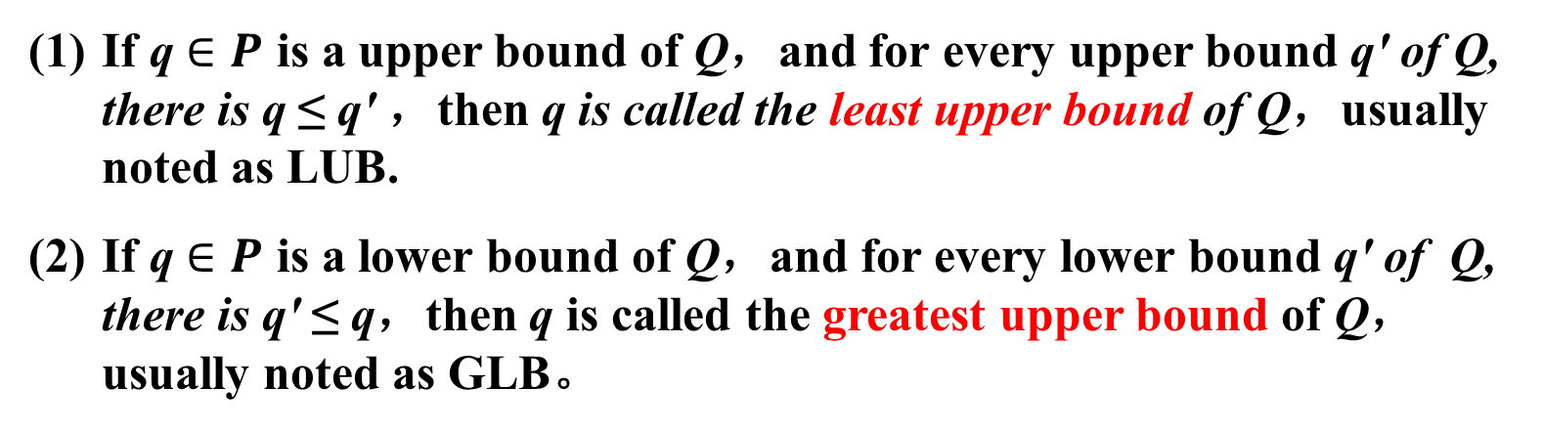
Partial ordered set and Hass Graph
特殊关系
集合的划分和覆盖
等价关系
相容关系
次序关系
偏序集合与哈斯图
Definition： let be a partial ordered set，and 。
If q $∈P$ is a upper bound of Q，and for every upper bound q' of Q, there is q ≤ q' ，then q is called the least upper bound of Q，usually noted as LUB.
If q $∈P$ is a lower bound of Q，and for every lower bound q' of Q, there is q' ≤ q，then q is called the greatest upper bound of Q，usually noted as GLB。
The least element of the set of the upper bounds of A is called the least upper bound (最小上界) of A.
The greatest element of the set of the lower bounds of A is called the greatest lower bound (最大下界) of A.
If there is a least upper bound, it is unique;
if there is a greatest lower bound, it is unique too.

Slide 31
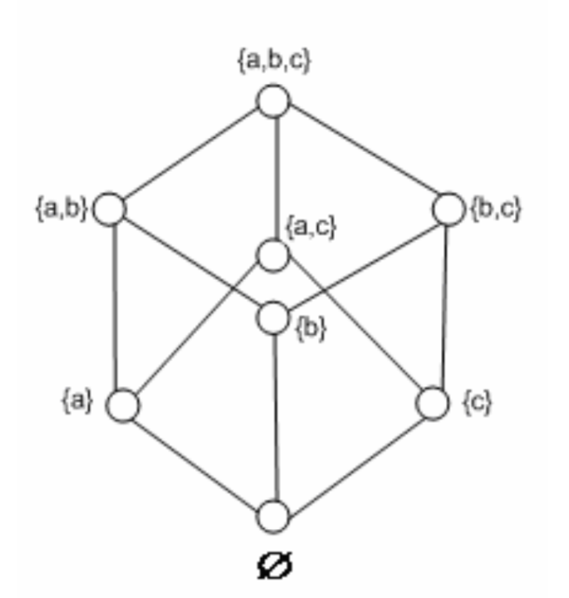
Bounds
特殊关系
集合的划分和覆盖
等价关系
相容关系
次序关系
偏序集合与哈斯图
A={2,3,6}
No lower bound
The set of upper bound is {6,12,24,36}，
so the least upper bound is 6
B={12,6}
The set of lower bound is {6,2,3}，
so the greatest lower bound is 6
The set of upper bound is {12,24,36}，
so the least upper bound is 12
Each subset has the least upper bound and the greatest lower bound.

Slide 32
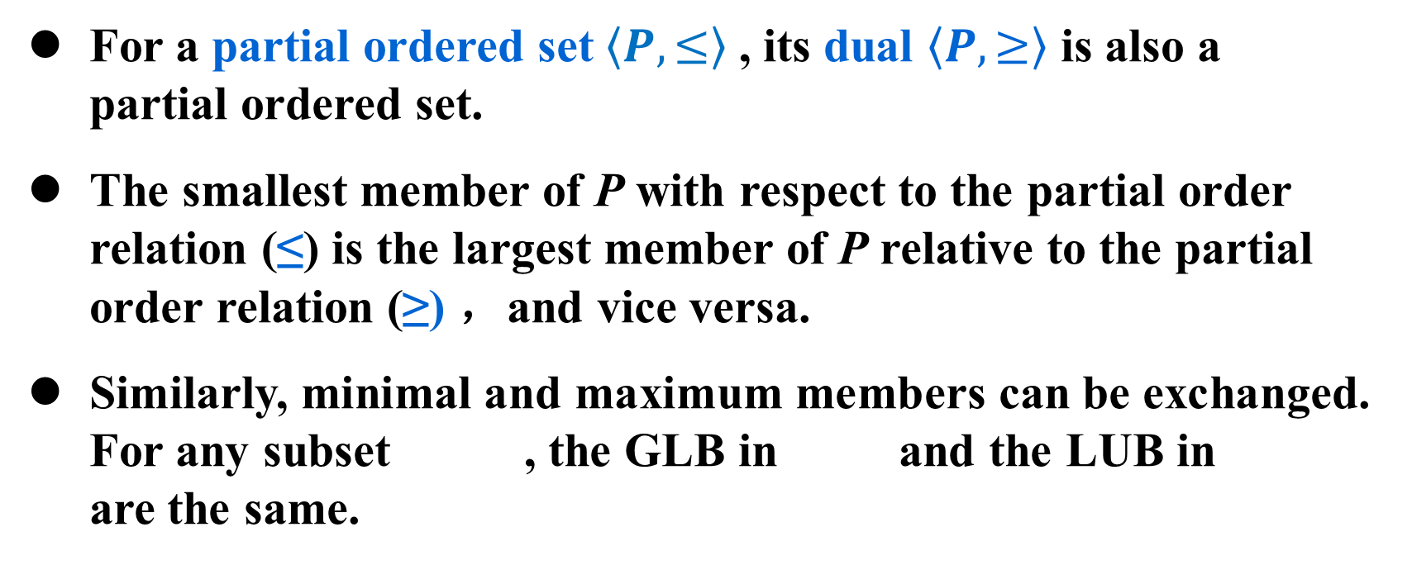
Partial ordered set and Hass Graph
特殊关系
集合的划分和覆盖
等价关系
相容关系
次序关系
偏序集合与哈斯图
For a partial ordered set $〈P,≤〉$ , its dual $〈P,≥〉$ is also a partial ordered set.
The smallest member of P with respect to the partial order relation (≤) is the largest member of P relative to the partial order relation (≥) ，and vice versa.
Similarly, minimal and maximum members can be exchanged. For any subset , the GLB in and the LUB in are the same.

Slide 33
Well-ordered (良序) relation
特殊关系
集合的划分和覆盖
等价关系
相容关系
次序关系
偏序集合与哈斯图
Definition：Let <S, ≤ > be a totally ordered set. If every nonempty subset of S has a least element, <S, ≤ > is called a well-ordered set, and ≤ is called well-ordered.
Example： <Z, ≤ > is a totally ordered set, but not a well-ordered set.
<N, ≤ > is a well order set
A finite totally ordered set is a well-ordered set.

Slide 34
Homework
Homework for Monday
P105：34,35,36,38,41
Homework for Wednesday
P106：
42
44,45,47,48（3）,50

Slide 35
Summarization
Ordered couple and Cartesian product
Basic concepts of relationships
Properties of relationships
Representation of relationships
Relationship diagram and matrix
Operation of relationships
Specific relationship：
equivalence relation and partition
compatibility relation and covering
partial ordering relation and Hasse diagram.

Slide 36

The End
Thanks

